Slide 1
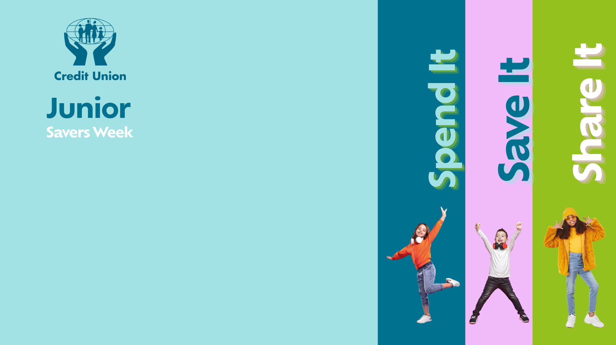

Slide 2

Question 1
What colour is the American dollar bill?
A) Blue
B) Green
C) Purple
D) Orange

Slide 3
Answer
B) GREEN

Slide 4

Question 2
If you had to choose, which would make you richer over time?
A) Saving €5 every week
B) Spending €5 every week
C) Saving €5 every month
D) Hiding €5 under your mattress

Slide 5
Answer
A) Saving €5 every week

Slide 6
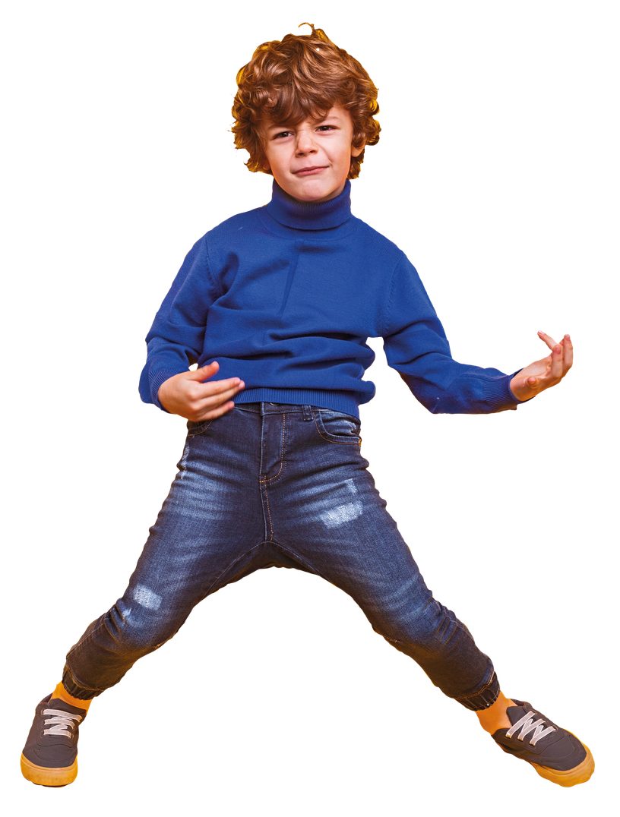
Question 3
Which one is most likely to be a WANT rather than a NEED?
A) Electricity
B) Food
C) A new pair of designer shoes
D) A place to live

Slide 7
Answer
C) A new pair of designer shoes

Slide 8
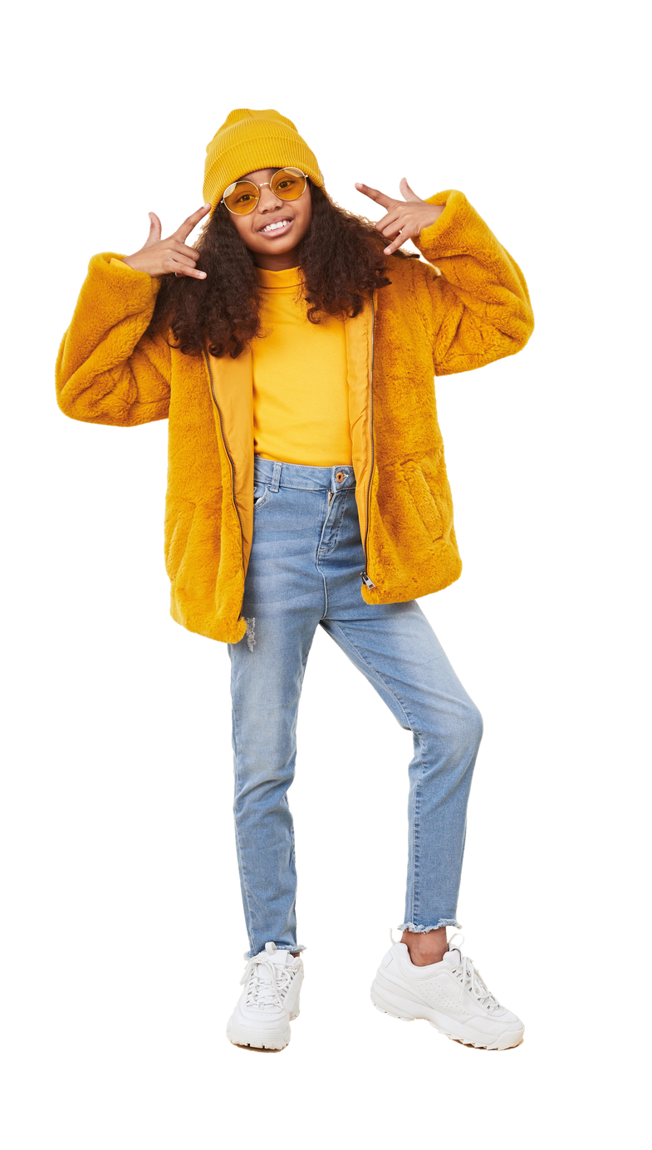
Question 4
You save €2/£2 every time you do a household chore. How many chores would you need to do to make €/£20?
A) 5
B) 10
C) 20

Slide 9
Answer
B) 10

Slide 10
Question 5
Which country uses the yen as its currency?
A) China
B) Japan
C) Thailand
D) South Korea

Slide 11
Answer
B) Japan

Slide 12
Question 6
Which country once made a coin shaped like a triangle?
A) The Cook Islands
B) Ireland
C) Canada
D) Brazil

Slide 13
Answer
A) The Cook Islands

Slide 14
Question 7
Which country has had a banknote that features a polar bear?
A) Greenland
B) Iceland
C) Russia
D) Finland

Slide 15
Answer
A) Greenland

Slide 16
Question 8
Why did some ancient coins have holes in them?
A) They were broken
B) They could be carried on strings
C) They were made for children
D) To make them lighter

Slide 17
Answer
B) They could be carried on strings

Slide 18
Question 9
Which of these is most likely to help
you save money?
A) Making a savings plan
B) Buying everything you see
C) Never checking your bank balance
D) Spending before you think

Slide 19
Answer
A) Making a savings plan

Slide 20
Question 10
Which country was the first to introduce paper money?
A) Italy
B) China
C) Egypt
D) France

Slide 21
Answer
B) China

Slide 22
Question 11
Which of these is NOT a currency?
A) Rupee
B) Franc
C) Peso
D) Sahara

Slide 23
Answer
D) Sahara

Slide 24
Question 12
What unusual feature can be found on some banknotes to help people who are visually impaired?
A) Braille-like markings
B) Raised printing
C) Different sized notes
D) All of these

Slide 25
Answer
D) All of these

Slide 26
Question 13
What does 'value for money' mean?
A) Always buying the cheapest option
B) Getting a good product or service for the price you pay
C) Spending as much as possible
D) Only buying things that are on sale

Slide 27
Answer
B) Getting a good product or service for the price you pay

Slide 28
Question 14
Which country has made banknotes out of plastic?
A) Australia
B) UK
C) Canada
D) All of the above

Slide 29
Answer
D) All of the above

Slide 30
Question 15
Which country once issued a square-shaped banknote?
A) Thailand
B) Australia
C) Fiji
D) Singapore

Slide 31
Answer
A) Bermuda

Slide 32
Question 16
Which of these is a 'need' rather than a 'want'?
A) The latest games console
B) Designer clothes
C) Food
D) A new phone when your current one works perfectly

Slide 33
Answer
C) Food

Slide 34
Question 17
Which is usually a good reason to save money?
A) To prepare for something you want or need in the future
B) To spend it all at once
C) To avoid keeping track of your money
D) To make your money disappear

Slide 35
Answer
A) To prepare for something you want or need in the future

Slide 36
Question 18
Which country once produced a banknote worth 100 trillion dollars?
A) India
B) USA
C) China
D) Zimbabwe

Slide 37
Answer
D) Zimbabwe

Slide 38
Question 19
In ancient Rome, what everyday item was reportedly used as a form of payment or compensation?
A) Olive Oil
B) Bread
C) Salt

Slide 39
Answer
C) Salt

Slide 40
Question 20
Which animal is featured on the Australian one-dollar coin?
A) Kangaroo
B) Platypus
C) Echidna
D) Koala

Slide 41
Answer
A) Kangaroo

