Slide 1
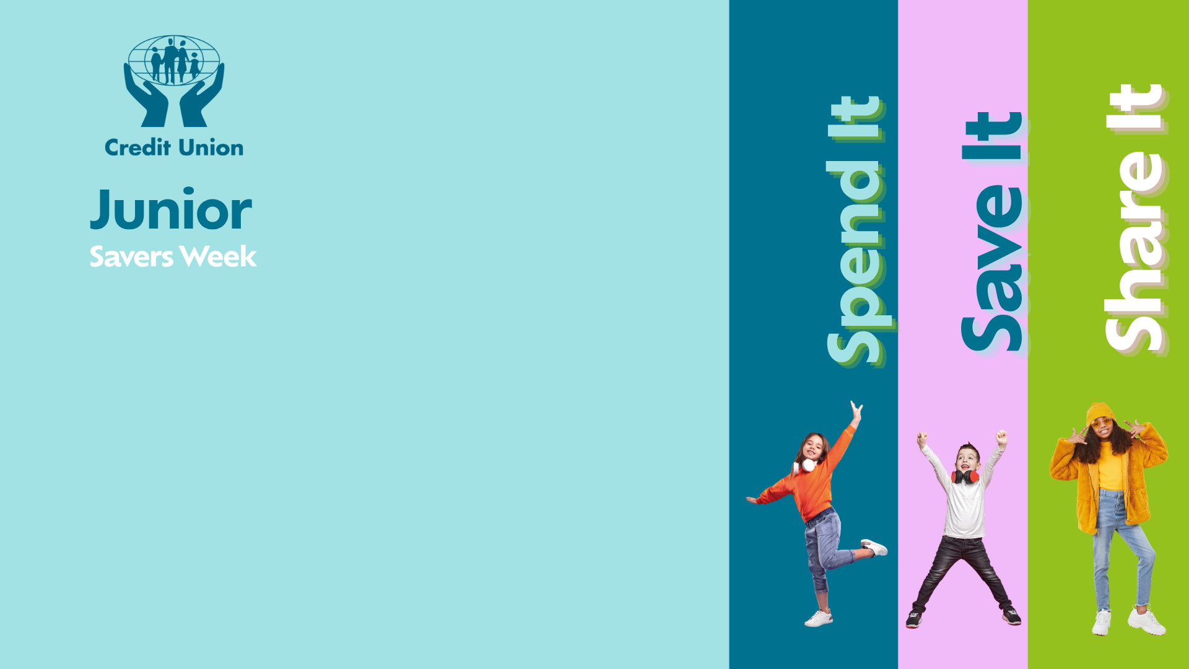

Slide 2

Question 1
What colour is the American dollar bill?
A) Blue
B) Green
C) Purple
D) Orange

Slide 3

Question 2
If you had to choose, which would make you richer over time?
A) Saving €5 every week
B) Spending €5 every week
C) Saving €5 every month
D) Hiding €5 under your mattress

Slide 4
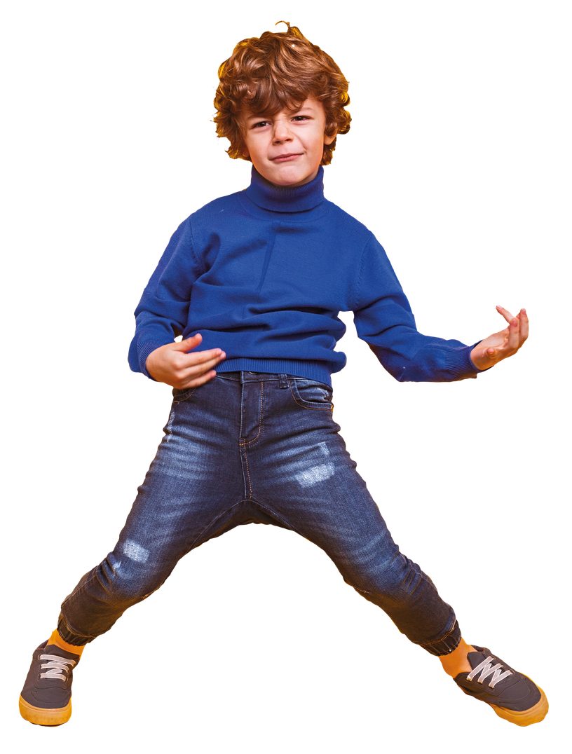
Question 3
Which one is most likely to be a WANT rather than a NEED?
A) Electricity
B) Food
C) A new pair of designer shoes
D) A place to live

Slide 5
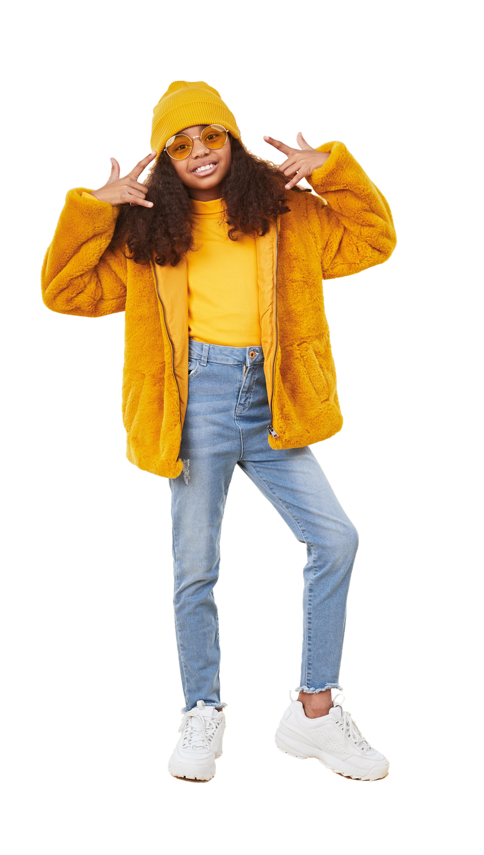
Question 4
You save €2/£2 every time you do a household chore. How many chores would you need to do to make €/£20?
A) 5
B) 10
C) 20

Slide 6
Question 5
Which country uses the yen as its currency?
A) China
B) Japan
C) Thailand
D) South Korea

Slide 7
Question 6
Which country once made a coin shaped like a triangle?
A) The Cook Islands
B) Ireland
C) Canada
D) Brazil

Slide 8
Question 7
Which country has had a banknote that features a polar bear?
A) Greenland
B) Iceland
C) Russia
D) Finland

Slide 9
Question 8
Why did some ancient coins have holes in them?
A) They were broken
B) They could be carried on strings
C) They were made for children
D) To make them lighter

Slide 10
Question 9
Which of these is most likely to help
you save money?
A) Making a savings plan
B) Buying everything you see
C) Never checking your bank balance
D) Spending before you think

Slide 11
Question 10
Which country was the first to introduce paper money?
A) Italy
B) China
C) Egypt
D) France

Slide 12
Question 11
Which of these is NOT a currency?
A) Rupee
B) Franc
C) Peso
D) Sahara

Slide 13
Question 12
What unusual feature can be found on some banknotes to help people who are visually impaired?
A) Braille-like markings
B) Raised printing
C) Different sized notes
D) All of these

Slide 14
Question 13
What does 'value for money' mean?
A) Always buying the cheapest option
B) Getting a good product or service for the price you pay
C) Spending as much as possible
D) Only buying things that are on sale

Slide 15
Question 14
Which country has made banknotes out of plastic?
A) Australia
B) UK
C) Canada
D) All of the above

Slide 16
Question 15
Which country once issued a square-shaped banknote?
A) Thailand
B) Australia
C) Fiji
D) Singapore

Slide 17
Question 16
Which of these is a 'need' rather than a 'want'?
A) The latest games console
B) Designer clothes
C) Food
D) A new phone when your current one works perfectly

Slide 18
Question 17
Which is usually a good reason to save money?
A) To prepare for something you want or need in the future
B) To spend it all at once
C) To avoid keeping track of your money
D) To make your money disappear

Slide 19
Question 18
Which country once produced a banknote worth 100 trillion dollars?
A) India
B) USA
C) China
D) Zimbabwe

Slide 20
Question 19
In ancient Rome, what everyday item was reportedly used as a form of payment or compensation?
A) Olive Oil
B) Bread
C) Salt

Slide 21
Question 20
Which animal is featured on the Australian one-dollar coin?
A) Kangaroo
B) Platypus
C) Echidna
D) Koala

